Slide 1
Information Model extraction & Analysis student-driven
Yi Xiang Tan (ICS)
Supervisor: Gaye Stephens

Slide 2
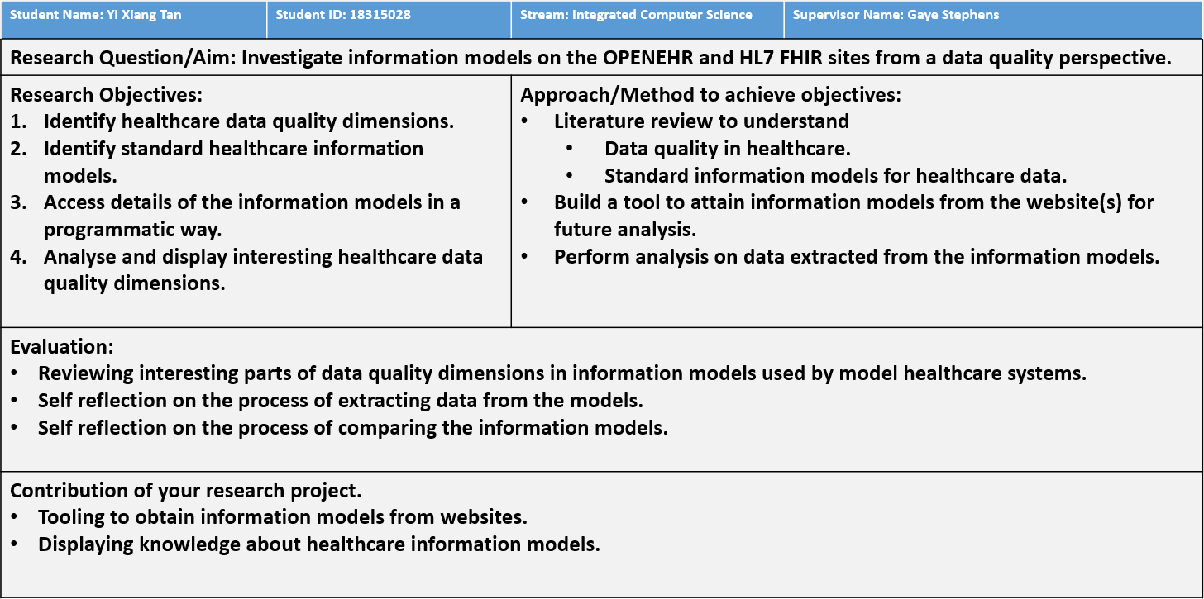

Slide 3
Motivation
People often ask, “what model?”, but seldom “how is the model?”.
Facilitate future research into analysis of the information models.
Explore interoperability of standardized models.
Personal Goals
Explore interdisciplinary domain.
Interested in a role in information modeling that only a developer could do.

Slide 4
Research Objective 1
Identify healthcare data quality dimensions
Relevancy
Accuracy
Consistency
Understandability
Representational
Format
Security
Timeliness
Accessibility
Reputation
Completeness
*These will be analysed,
either on one or both sources

Slide 5


Research Objective 2
Identify Standard Healthcare Information models
OpenEHR
https://ckm.openehr.org/ckm/
HL7 - FHIR
https://www.hl7.org/fhir/

Slide 6
Research Objective 3
Access details of the information models in an automatic way.
Approach | Problems | Outcome
Look for APIs | There are not APIs for FHIR None of the OpenEHR APIs are useful for this project | Rejected
Look for available resources | Only OpenEHR provides them via bulk exports The models exported contains many uninteresting properties, and some interesting properties were not included. | Rejected
Web scraping | Some challenges | Chosen approach
What I did:
Literature research
Web-surfing
Banging my head against the wall

Slide 7
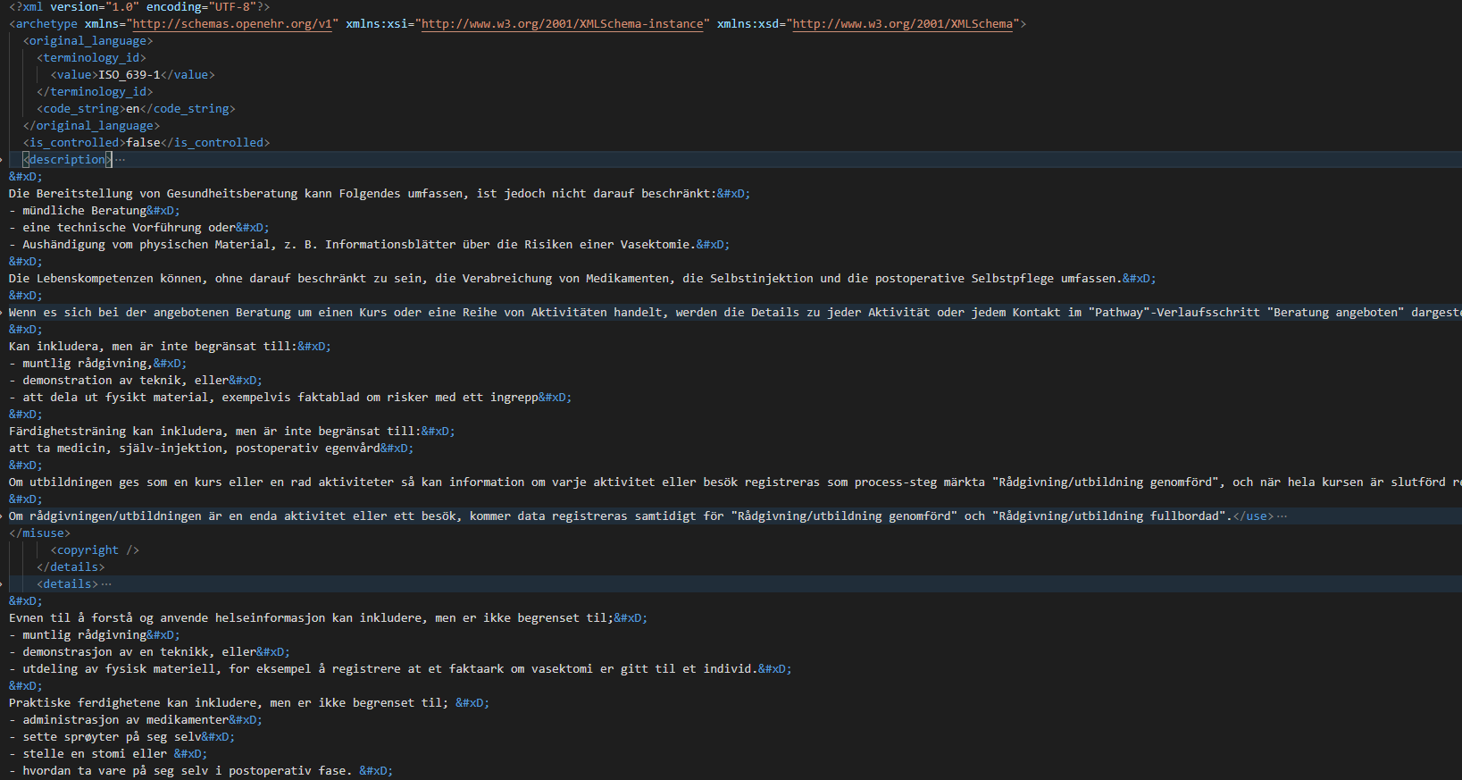
OpenEHR (bulk-exported)

Slide 8
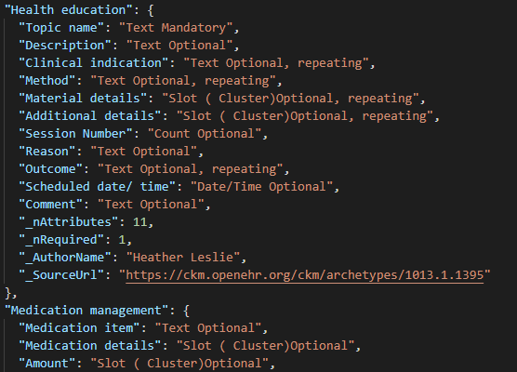
Interesting (scraped)

Slide 9
Research Objective 3
Access details of the information models in an automatic way.
Approach | Problems | Outcome
Look for APIs | There are not APIs for FHIR None of the OpenEHR APIs are useful for this project | Rejected
Look for available resources | Only OpenEHR provides them via bulk exports The models exported contains many uninteresting properties, and some interesting properties were not included. | Rejected
Web scraping | Some challenges | Chosen approach
What I did:
Literally research
Web-surfing
Banging my head against the wall

Slide 10
Approach
Web scraping
Problem
Static website (FHIR) vs Single Page Application (OpenEHR)
Anonymous classname
Duplicate selectors
Invalid format (FHIR, JSON format)
Invalid comments
Invalid object notation
Missing commas
IP/MAC bans

Slide 11
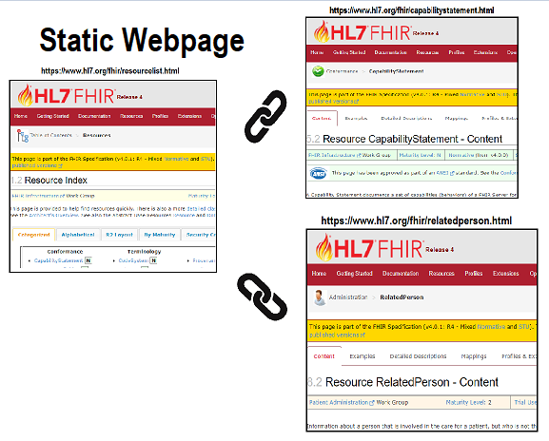
Each link LINKs to an actual DOCUMENT

Slide 12
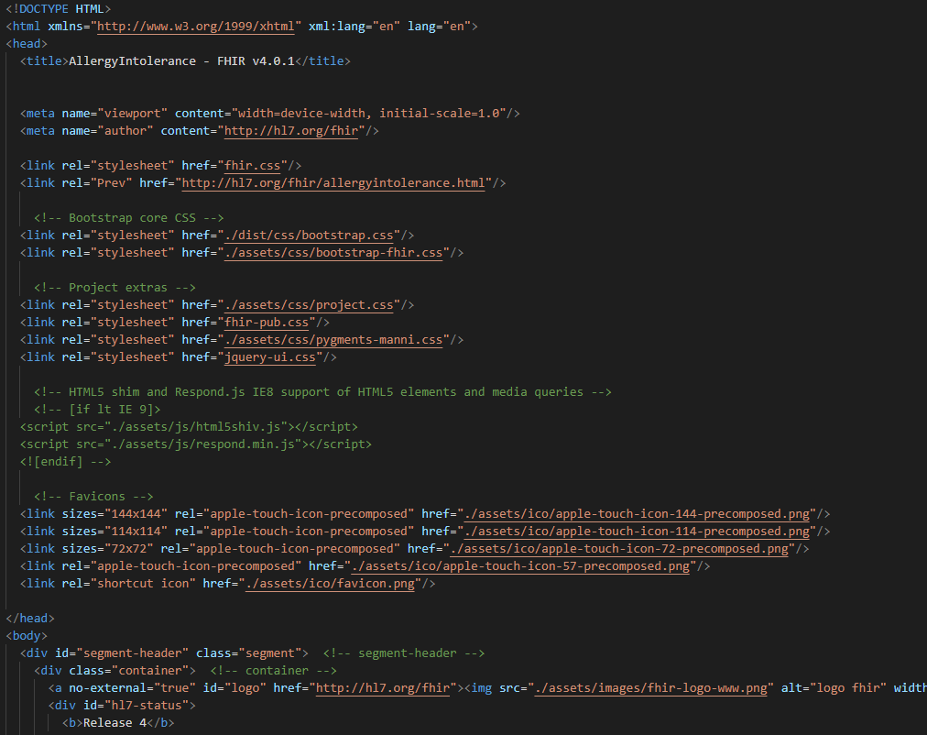
Each link LINKs to an actual DOCUMENT

Slide 13
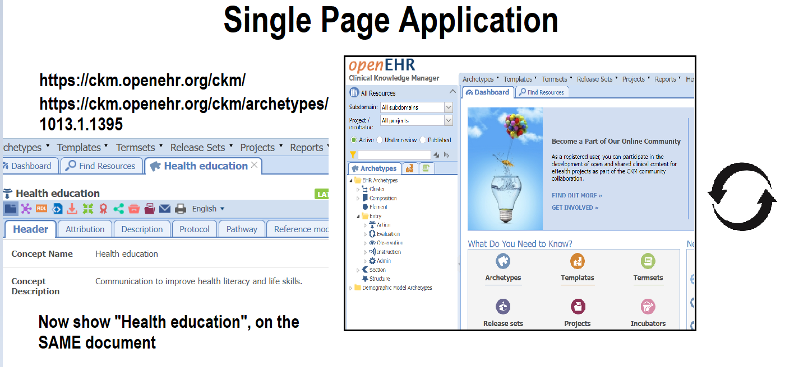

Slide 14
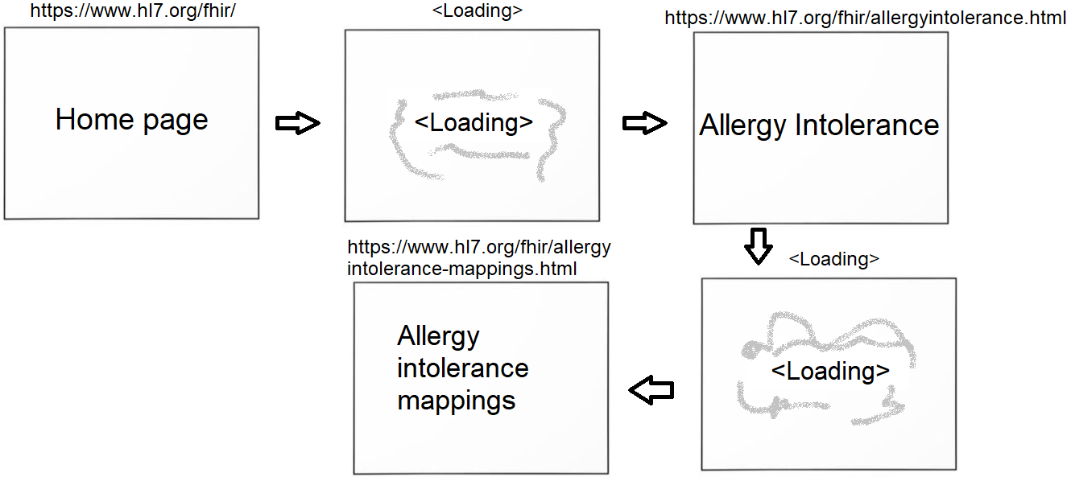
Each link changes the STATE of the document
Think of getting a whiteboard, and then erase and draw on the SAME whiteboard

Slide 15
Approach
Web scraping
Problem
Static website (FHIR) vs Single Page Application (OpenEHR)
Anonymous classname
Duplicate selectors
Invalid format (FHIR, JSON format)
Invalid comments
Invalid object notation
Missing commas
IP/MAC bans

Slide 16
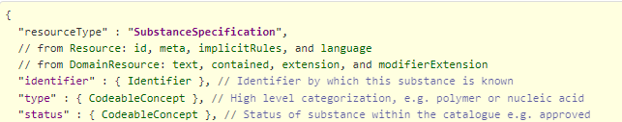


Invalid format (FHIR, JSON format)
https://www.hl7.org/fhir/substancespecification.html
Invalid comments
(JSON does not support comments)
Missing commas
(Commas are used to separate attributes)
Invalid attribute notation
(Complex structure are not recognized)

Slide 17



Challenges (OpenEHR)
https://ckm.openehr.org/ckm/archetypes/1013.1.3273
Inconsistent Naming

Slide 18
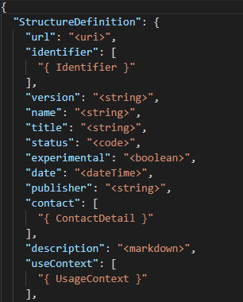
The Scraped Models
OpenEHR
FHIR

Slide 19

Analysis Challenges
Research Objective 4
Analyse and display interesting healthcare data quality dimensions.
Identifying base types
Identifying complex types
Tying attributes with quality dimensions
Extrapolate quality dimensions not just from the models
Types do not provide a full picture
One is of type “Date/Time”, the other “Choice”

Slide 20
Analyzed dimensions
Timeliness
Accessibility
Reputation
Completeness
Understandability
Representational
Format
Security

Slide 21
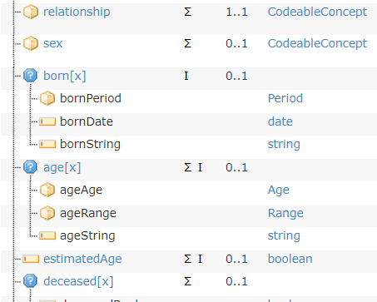

Data Quality Analysis
Representational:
Conciseness of information models
OpenEHR
FHIR

Slide 22

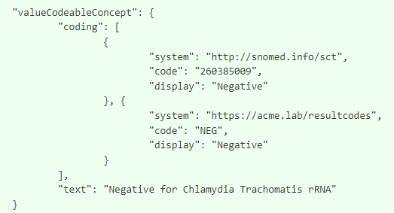
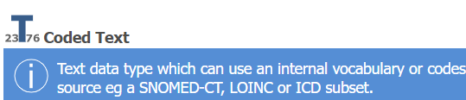

Data Quality Analysis
Representational:
Conciseness of information models
OpenEHR
FHIR

Slide 23
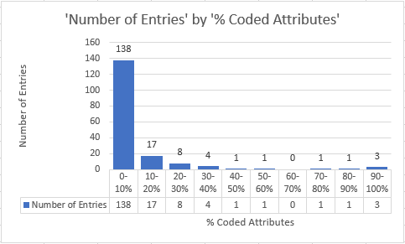
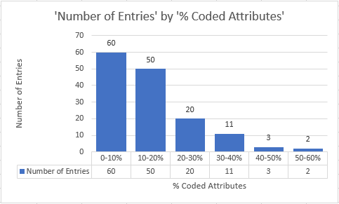
Data Quality Analysis
Representational
OpenEHR
FHIR
Out of 174 published information models,
49 contains coded attributes (28.16%)
Out of 146 information models,
129 contains coded attributes (88.36%)

Slide 24


Data Quality Analysis
Timeliness: Number of time-related attributes in information models
OpenEHR
FHIR

Slide 25
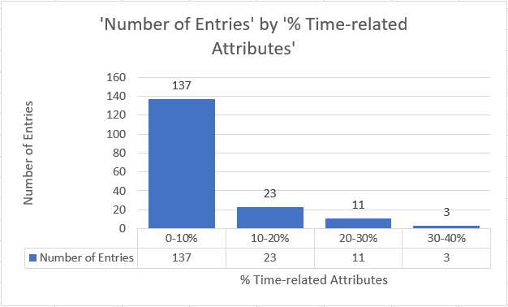
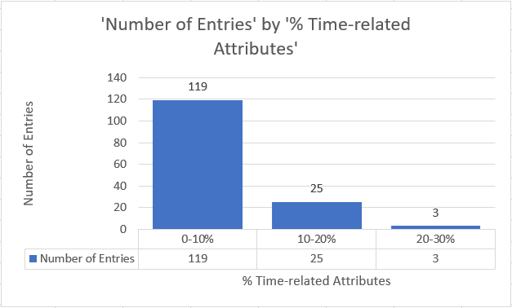
Data Quality Analysis
Timeliness: Number of time-related attributes in information models
OpenEHR
FHIR
Out of 174 published information models,
45 contains attributes related to time (25.86%)
Out of 146 information models,
94 contains attributes related to time (64.38%)

Slide 26
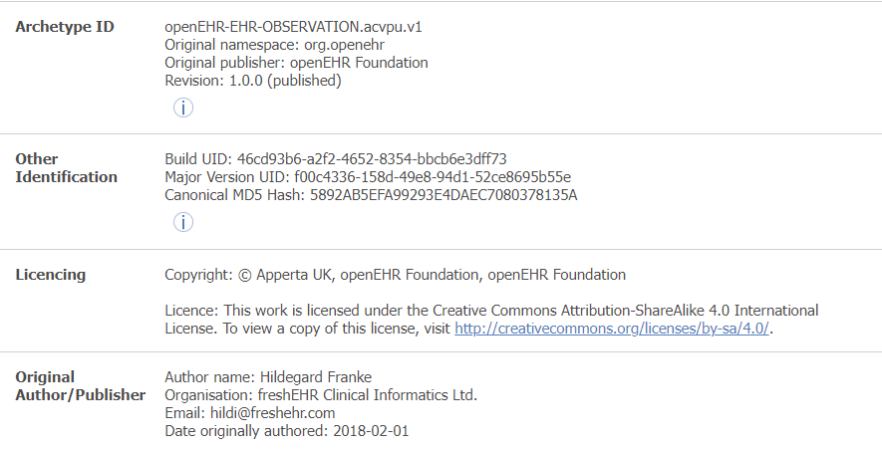
Data Quality Analysis
Reputation: Source of information models
Does not
credit authors
OpenEHR
FHIR
N/A

Slide 27
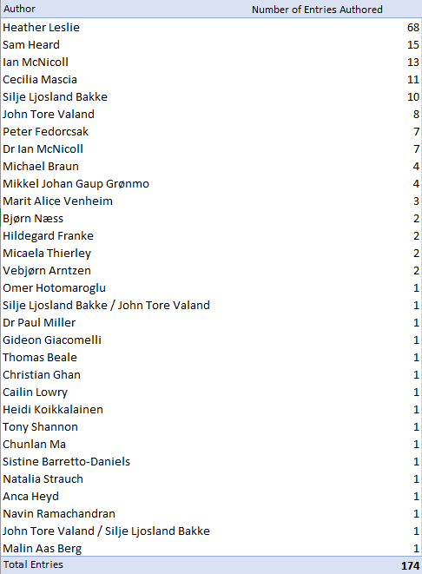
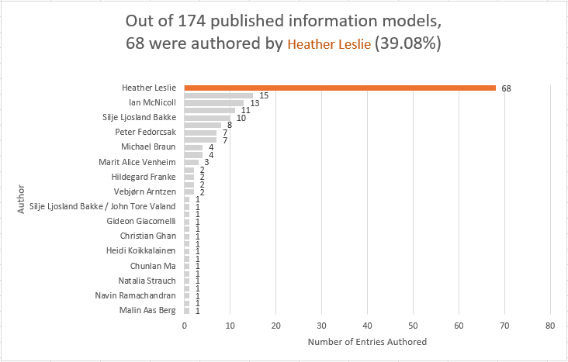
Data Quality Analysis
Reputation
OpenEHR

Slide 28
Reflection 1
Extracting information
Was a lot of work.
Hard to maintain (without experience).
Making too many API calls, disturbing website normal services.
Two sites (FHIR/OpenEHR) uses two different layout, effectively means we must maintain two tools.
Models extracted were not 1-1, effectively means we must do the analysis separately.

Slide 29
Reflection 2
Comparing information models
Comparison between each dimensions does not paint a clear conclusion on which is better.
Possible to combine both to harness strength and eliminate weaknesses?
FAIR
Findable
Accessible
Interoperable
Reusable

Slide 30
Reflection
Interoperability:

Slide 31
Reflection
Interoperability:

Slide 32
Interoperability barriers:
Different Attribute Names.
Different Primitive Types.
Different Attribute Properties (EHR’s repeating).
Different Formats (JSON/ADL).
Common Format (XML) structured information very differently.

Slide 33
Conclusion
Gained insight into healthcare information system.
Explored measurements of data quality.
Gained experienced into scraping information from two main layouts
(Static Webpage & Single-Page Application).
Understanding the difficulty to create tools that is useful and simple to be used by people from other domains (non-developers).
Understanding the limitation of different information models.

Slide 34
Vision for future
Suggestion
For two sources to have an easier way to export data models.
Improve interoperability by creating 1-1 mappings. (i.e. Coded Text and CodeableConcept).
To have a web service that simplifies the process of data model analysis.
Includes scraping.
No-code approach.
To explore the use of standardized information model system.

Slide 35
references
Discovering Data Quality Problems
Zhang, R., Indulska, M. & Sadiq, S. Discovering Data Quality Problems. Bus Inf Syst Eng 61, 575–593 (2019). https://doi.org/10.1007/s12599-019-00608-0
Dimensions and assessment methods of data quality in health information Systems
JAHANPOUR ALIPOUR1, 2, MARYAM AHMADI (2017)
The FAIR Guiding Principles for scientific data management and stewardship
Mark D. Wilkinson,¹ Michel Dumontier (2016). https://www.ncbi.nlm.nih.gov/pmc/articles/PMC4792175/

Slide 36
Analyzed dimensions
Timeliness
Accessibility
Reputation
Completeness
Understandability
Representational
Format
Security

Slide 37
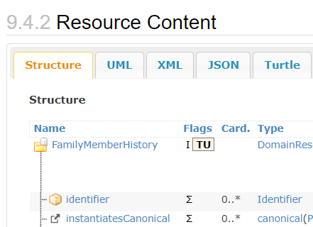
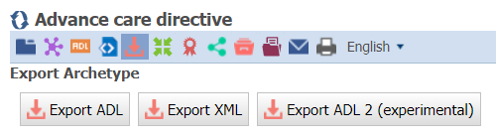
Data Quality Analysis
Understandability:
Models’ representation is comprehendible by machines.
OpenEHR
FHIR

Slide 38
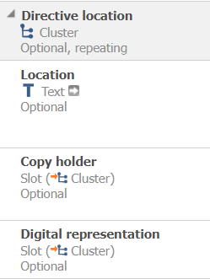
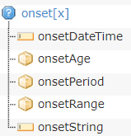
Data Quality Analysis
Understandability:
Structed data is easier to understand.
OpenEHR
FHIR

Slide 39
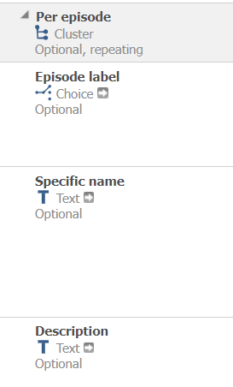

Shortcomings (OpenEHR)
https://ckm.openehr.org/ckm/archetypes/1013.1.3273
Can’t analyze complex types

Slide 40
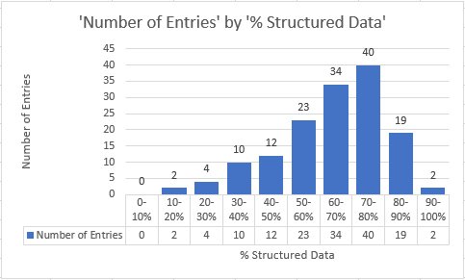
Data Quality Analysis
Understandability: Availability of structed data in information models.
OpenEHR
FHIR
N/A
Out of 146 information models,
146 contains structured data related (100%)

Slide 41
Data Quality Analysis
Representational:
Conciseness of data models
OpenEHR
FHIR

Slide 42
Data Quality Analysis
Representational:
Conciseness of data models
OpenEHR
FHIR

Slide 43
Data Quality Analysis
Representational
OpenEHR
FHIR
Out of 174 published information models,
49 contains coded attributes (28.16%)
Out of 146 information models,
129 contains coded attributes (88.36%)

Slide 44
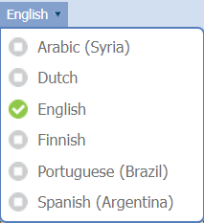

Data Quality Analysis
Format: Number of languages available
There are projects to translate this to other languages (e.g. Russian and Japanese ),
but these are generally not well maintained.
OpenEHR
FHIR

Slide 45
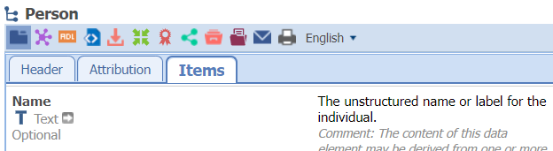
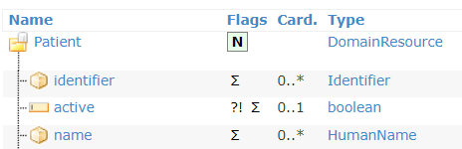
Data Quality Analysis
Security: How confidential is the information models
OpenEHR
FHIR

Slide 46
Data Quality Analysis
Timeliness: Number of time-related attributes in information models
OpenEHR
FHIR

Slide 47
Data Quality Analysis
Timeliness: Number of time-related attributes in archetypes
OpenEHR
FHIR
Out of 174 published information models,
45 contains attributes related to time (25.86%)
Out of 146 information models,
94 contains attributes related to time (64.38%)

Slide 48




Data Quality Analysis
Accessibility: Availability of information on archetype models
https://ckm.openehr.org/ckm/
https://www.hl7.org/fhir/resourcelist.html
https://github.com/openEHR/CKM-mirror
https://github.com/hl7/fhir
OpenEHR
FHIR

Slide 49
Data Quality Analysis
Reputation: Source of information models
Does not
credit authors
OpenEHR
FHIR
N/A

Slide 50
Data Quality Analysis
Reputation
OpenEHR

Slide 51
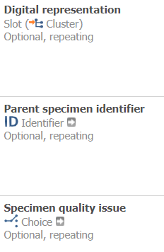
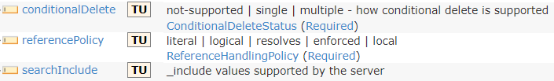
Data Quality Analysis
Completeness: Availability of optional attributes
OpenEHR
FHIR

Slide 52
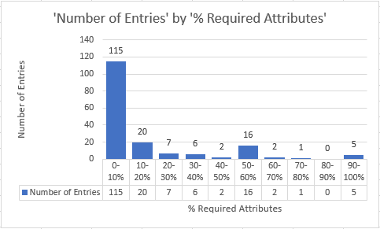
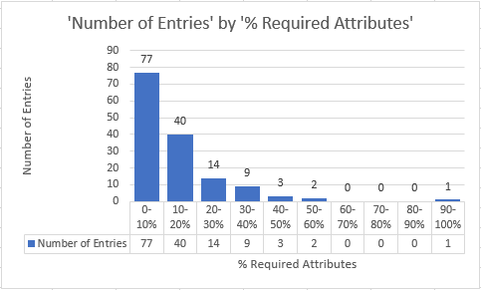
Data Quality Analysis
Completeness
OpenEHR
FHIR
Out of 174 published information models,
76 contains required attributes (43.68%)
Out of 146 information models,
123 contains required attributes (84.25%)

